Slide 1
Discussion & Lecture Session Sound & Recording Check
Remote participants:
Log into Join.me
Announce yourself and provide your name on the phone and/or in the chat session
For Screen Sharing utilize your computer
For conference call audio utilize your computer speakers and microphone OR dial into the session with your mobile phone
Onsite participants:
Sit in a good spot near the “speaker phone” if possible
Optionally sign into Join.me… but make sure that your microphone and speakers are muted/off
Test recording by starting recording and then stop recording after a few seconds
Check recording sound when video is released by Join.me

Slide 2

Object-Oriented Programming Discussion, Lecture, & Lab Eric Pogue
Agenda for Wednesday, January 22nd at 9am CT:
Friendly Conversation Topic
Prework
Demos
Sprint 1 Retrospective
Foreshadowing FaceDraw
Sprint 2 Planning
Design Patterns & MVC
Files & JSON
UML
Software Licensing & Copyrights
Assignment for Next Class
Lab
Discussion & Questions welcome at any time… please be present with no phones or email during our time together
Notes:
I hope everyone had a wonderful holiday and is coming back recharged and ready for a new semester.

Slide 3
Object-Oriented Programming with Web Development

Slide 4
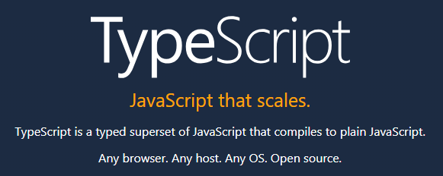

Slide 5
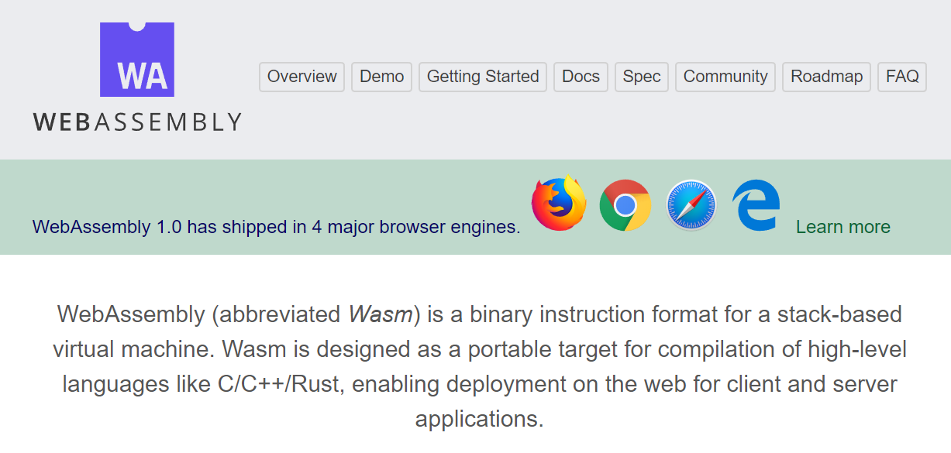

Slide 6
Prework
Review Monday prework announcement.

Slide 7

Scrum Demo - Potentially Shippable Product
By Dr ian mitchell - Own work, CC BY-SA 4.0, Link
Notes:
Calendar, Activities List, and Assignments

Slide 8
Demos
Notes:
Grace period until Monday morning a 6am CT

Slide 9
Demo Guidelines – Presenter
Everyone will give at least one demo of their work during the semester.
Your demo can include any or all of the following:
A 2 to 5 minute activity
Where you show your application running
Comment on your implementation
Show the source code
Explain how you organized the code
Talk about any challenges
You should not prepare slides or a presentation

Slide 10
Demo Guidelines – Listener
Everyone will be listening to many demos during the semester.
Your responsibilities during the demo is:
Actively listen and watch what is being demoed
Come up with a meaningful yet easy to answer question
During or after the demo ask your question if the presenter does not get “sufficient” questions from other listeners
Do not ask hard question or attempt to review the presenters code
Clap for the presenter at the end of the demo and thank them for presenting
If you have a hard question or want to make a recommendation, do it later and in private

Slide 11
Demos

Slide 12
Scrum Process – Sprint Retrospective
By Dr ian mitchell - Own work, CC BY-SA 4.0, Link
Notes:
Calendar, Activities List, and Assignments

Slide 13
Start, Stop, Continue Retrospective Feedback Model
Continue: What is working? Something that we should make sure that we continue to do.
Start: What is something that would be nice to do that we are not doing now? Maybe something that you have seen work well in other classes or with other teams.
Stop: What is not working? Something that we should stop doing.

Slide 14
Continue: Turning in Assignments on Time! Well Done!!!

Slide 15
Feedback?

Slide 16
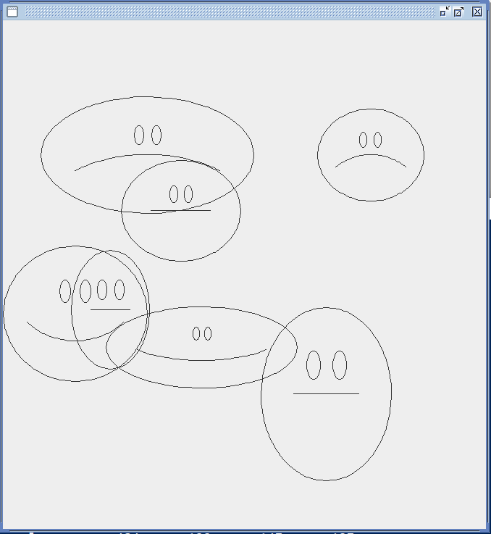
Foreshadowing FaceDraw
In the sprint 3 FaceDraw assignment, you will need to:
Create a graphical Java application
Draw 3 to 10 random faces on a window
Make each face a random width and height
Give each face a random emotion
Make it all visually appealing
And more
It will be challenging!

Slide 17
Scrum Process & Roles – Sprint Planning
By Dr ian mitchell - Own work, CC BY-SA 4.0, Link
Notes:
Calendar, Activities List, and Assignments

Slide 18
Design Patterns (Who are the Gang of Four?)

Slide 19


Model-View-Controller (MVC)
Diagram of interactions within the MVC pattern.
Model–view–controller is an architectural pattern commonly used for developing user interfaces that divides an application into three interconnected parts. This is done to separate internal representations of information from the ways information is presented to and accepted from the user.[1][2] The MVC design pattern decouples these major components allowing for efficient code reuse and parallel development.
Traditionally used for desktop graphical user interfaces (GUIs), this architecture has become popular for designing web applications and even mobile, desktop and other clients.[3] Popular programming languages like Java, C#, Ruby, PHP have MVC frameworks that are used in web application development straight out of the box

Slide 20
Files & JSON

Slide 21
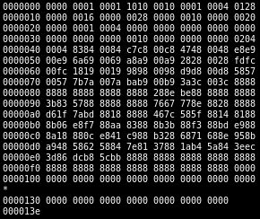
Binary Files
A binary file is a computer file that is not a text file. The term "binary file" is often used as a term meaning "non-text file". The can be open or closed formats that are generally:
Fast, small, and efficient*
Often not very portable across applications and platforms
Difficult to maintain backward compatibility
Notes:
Some people would say that binary files include all files, and that text files are just binary files that are being interpreted in a specific way.

Slide 22

Recall: Text File Encoding Standards
ASCII
Unicode
UTF-8
Others

Slide 23
Recall: Text File End-Of-Line (EOL) and Encoding
Industry adoption of end-of-line encoding includes:
Windows: Both Carriage Return (CR, \r, 0x0d) and Line Feed (LF, \n, 0x0a) together.
Unix/Linux/OSX: Just Line Feed (LF, \n, 0x0a)
Mac (pre-OSX): Just Carriage Return (CR, \r, 0x0d)
Article on Windows Notepad supporting non-Windows EOF conventions [link]

Slide 24
Special Types of Text Files
Most programming is made up of different types of Text Files including:
HTML
CSS
JavaScript… and other coding languages
XML
JSON

Slide 25
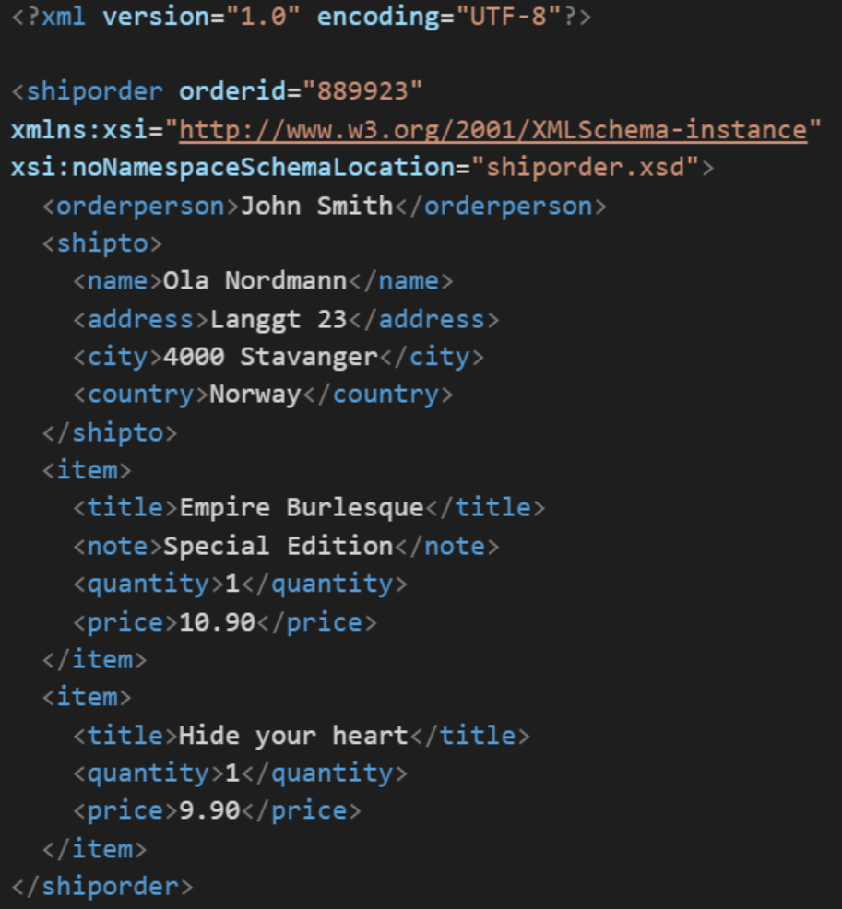
XML Example
In computing, XML (Extensible Markup Language) is a markup language that defines a set of rules for encoding documents in a format that is both human-readable and machine-readable. It is an open standard that:
Supports nearly all development languages and platforms
Allows us to cross between many applications
Can result in large files
Supports schema to validate data directly

Slide 26
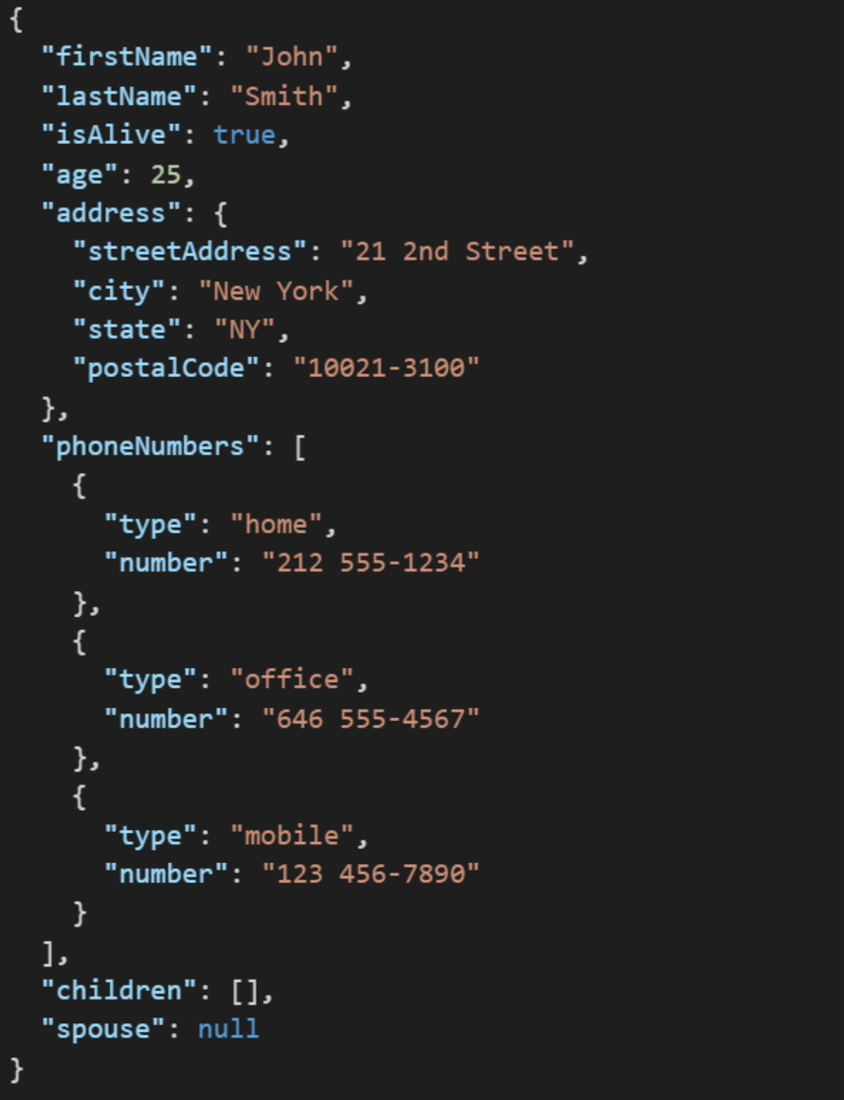
JSON Example
JSON (JavaScript Object Notation) is a lightweight data-interchange format. It is easy for humans to read and write. It is easy for machines to parse and generate. It is an open standard that:
Supports nearly all development languages and platforms
Allows us to cross between many applications
Can result in large files
Notes:
JSON is an open-standard format that uses human-readable text to transmit data objects consisting of attribute–value pairs. It is a very common data format used for asynchronous browser/server communication, including as a replacement for XML in some web service style systems.

Slide 27
Question: What is the difference between a UTF-8 XML file that contains only ACSII characters and an ACSII XML file?

Slide 28

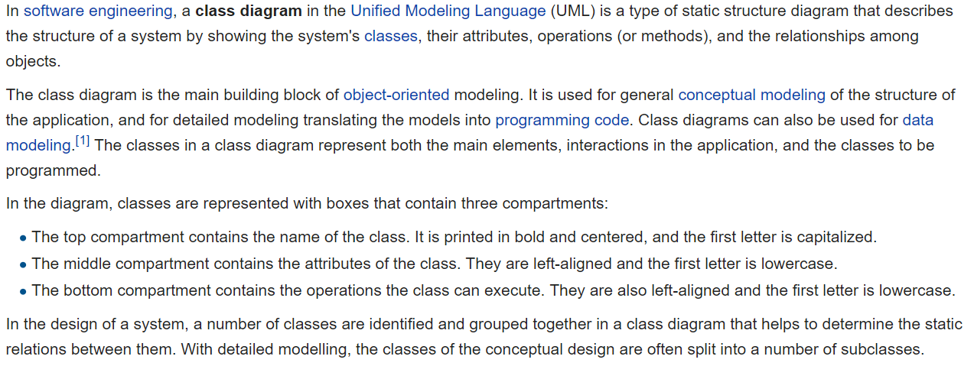
UML Class Diagram [link]

Slide 29
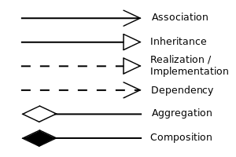


UML Class Diagram (continued) [link]

Slide 30
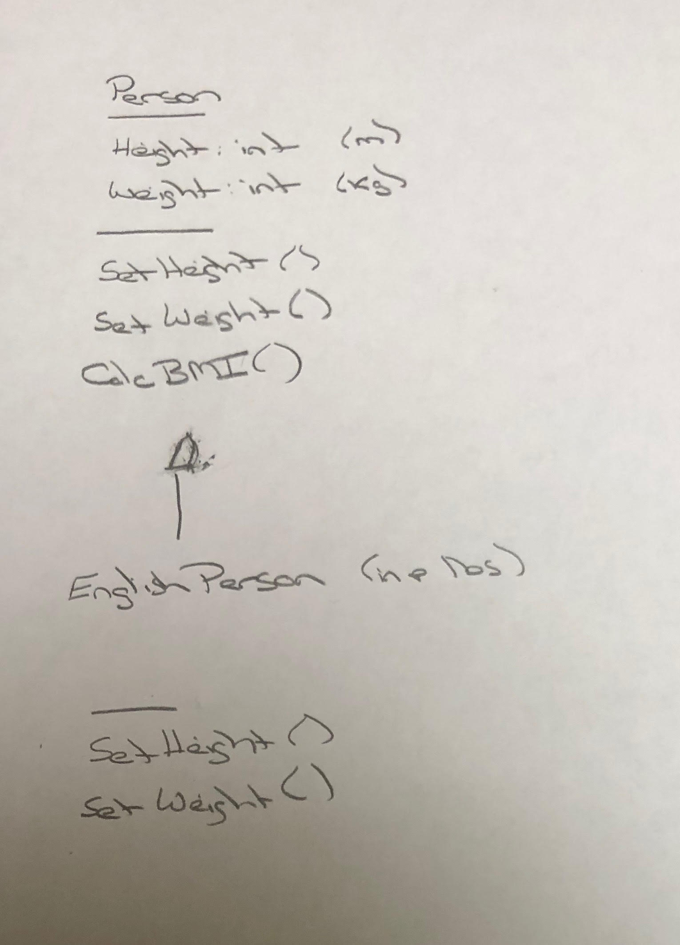
UML – BMI Calculator Plus

Slide 31
Software Licenses & Copyrights

Slide 32
Preview
Principles – Software design principles represent a set of guidelines that allow us to create high quality object-oriented designs
Design characteristics to avoid include Rigidity, Fragility, and Immobility
The prevalence of Agile development has made design Principles even more important
Key design Principles include:
Single-Responsibility Principle
Open-Closed Principle
Liskov's Substitution Principle
Dependency-Inversion Principle
Interface-Segregation Principle

Slide 33
Assignment
ALL Assignments & Activity List Items are due this Sunday.
Prework assignments for next sprint will be communicated by Monday noon in preparation for our session next week
Notes:
Grace period until Monday morning a 6am CT

Slide 34
Break & End of First Recording

Slide 35
Lab
As A Group:
Review Model-View-Controller (MVC) Pattern
Review OvalDraw
Review Shapes Tutorials
Notes:
git clone https://github.com/EricJPogueCourses/OOP-ExampleCode.git

Slide 36
End of Session & Recordings

Slide 37
Backup Slides

Slide 38
Agile Manifesto
Agile Team Commitments:
Everyone is a team member and is responsible for getting the work done (we don’t need titles and positions)
We will actively and voluntarily play important roles on our team
The rules (rituals) that we do have… we WILL follow
We will create, demo, and release working software products
We will utilize practical processes, tools, documentation, and planning
When we make commitments, we will live up to those commitments… as a team (“No winners on a losing team, and no losers on a winning team”)
We will be responsive and continuously improve (Retrospectives)
We will be transparent with how WE work and share our information
Notes:
Agile Team Commitments
Everyone is a team member and is responsible for the work getting done
we don’t need no titles or positions
self-organizing
we will make our own commitments
transparency (let’s share the information)
flexible/organic teams, organic architecture (minimal appropriate documentation/standards)
no contracts (let’s talk it over)

Slide 39
Friendly Conversation Topic – Source Code Snippets in VS Code

Slide 40
One Space or Two Spaces After a Period?

Slide 41
Only One Space After a Period
Rule: Utilize one space after a period or similar punctuation [link]
Proportional based fonts like Helvetica and Times were designed to have the most visually appealing amount of space after the period.
Notes:
A possible exception would be non-proportional based fonts

Slide 42
Bonus MacOS Topic [link]
Notes:
And to stop zsh beeps:
unsetopt BEEP
setopt BEEP

Slide 43
Discussion: Shapes Step 1

Slide 44
Lab
As A Scrum Team:
Fix OvalDraw Together
Select two team members that will each share one OOP Principle or Design Characteristic
Programming Together – By Request
Programming Assignment 2 and Shapes Tutorials
Team report out by Scrum Master at 2:46
Team Report Out Guidelines
Scrum Master will stand up, give your name, your team name, and briefly answer the following questions:
What did you accomplish since the last meeting? And what will you be working on until the next meeting?
Is the team committed to completing assignments? All/Most/Some
What is getting in your way or keeping you from completing the assignments?

Slide 45
Lab
As A Scrum Team:
Review SOLID Design Principles
Prepare and share your OOP Principle or Design Characteristic including acronym
Review HelloWorld Plus upon request
Sprint 2 Assignments
Team report out by Scrum Master at 2:46
Team Report Out Guidelines
Scrum Master will stand up, give your name, your team name, and briefly answer the following questions:
What did you accomplish since the last meeting? And what will you be working on until the next meeting?
Is the team committed to completing assignments? All/Most/Some
What is getting in your way or keeping you from completing the assignments?

Slide 46

Agile Design Principles
Software design principles represent a set of guidelines that allow us to create high quality object-oriented designs. The design principles are attributed to Robert Martin who gathered them in the book "Agile Software Development: Principles, Patterns, and Practices".
According to Robert Martin there are 3 important characteristics of a bad design that should be avoided:
Rigidity – The system is hard to change, even to implement what seems like simple changes.
Fragility – The system tends to break in many places when a single change is made. And fixing the problems tend to lead to more creates more issues.
Immobility – The system is hard to reuse in another application because it cannot be disentangled from the current application.
Plus Viscosity, Needless Complexity, Needless Repetition, and Opacity.
Notes:
Our procedural (C) implementation of BMI would be a great example of Immobility… maybe a good example of all three of these.

